Slide 1

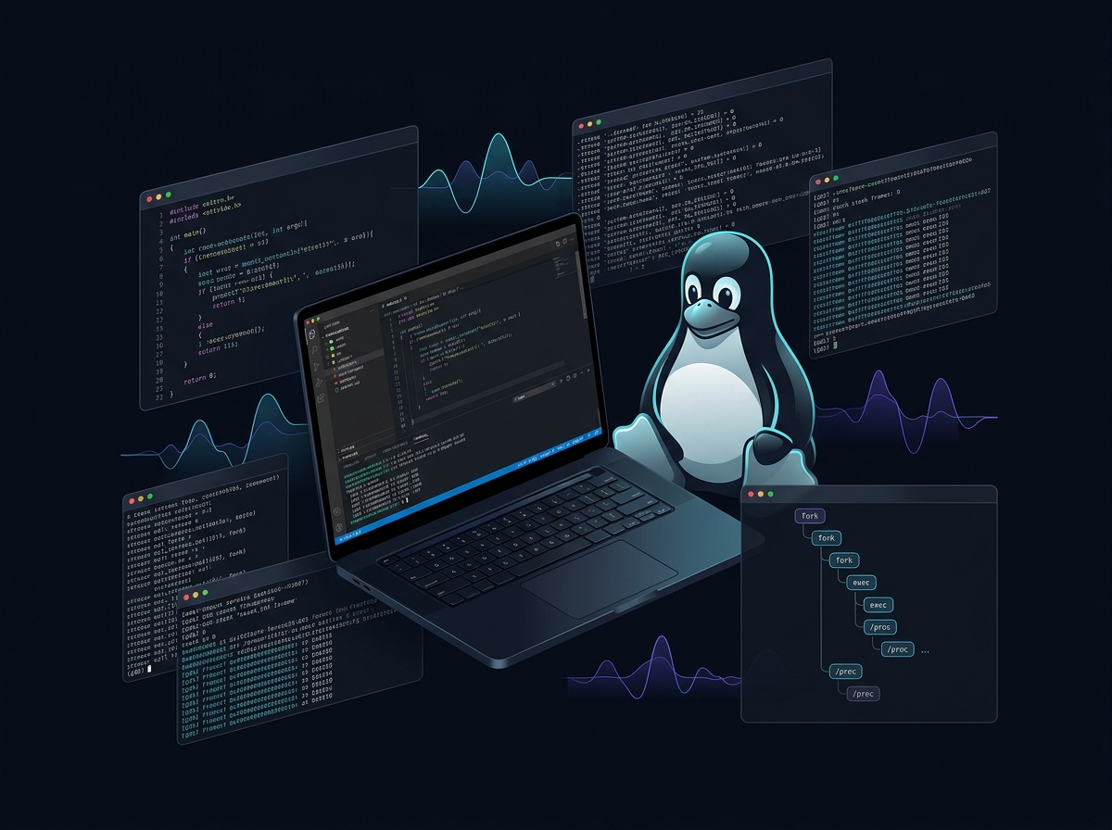
LINUX SYSTEM
DEBUGGING TOOL
Trace. Analyze. Debug. Understand.
A real Linux debugging environment with a C core, terminal CLI and premium local web workspace.
GCC
strace
/proc
GDB
Flask GUI
M Nihal • Madhan Gopal • Thrinadh
OSSP (25CS2104E) | Section 7 | Team 15

Slide 2
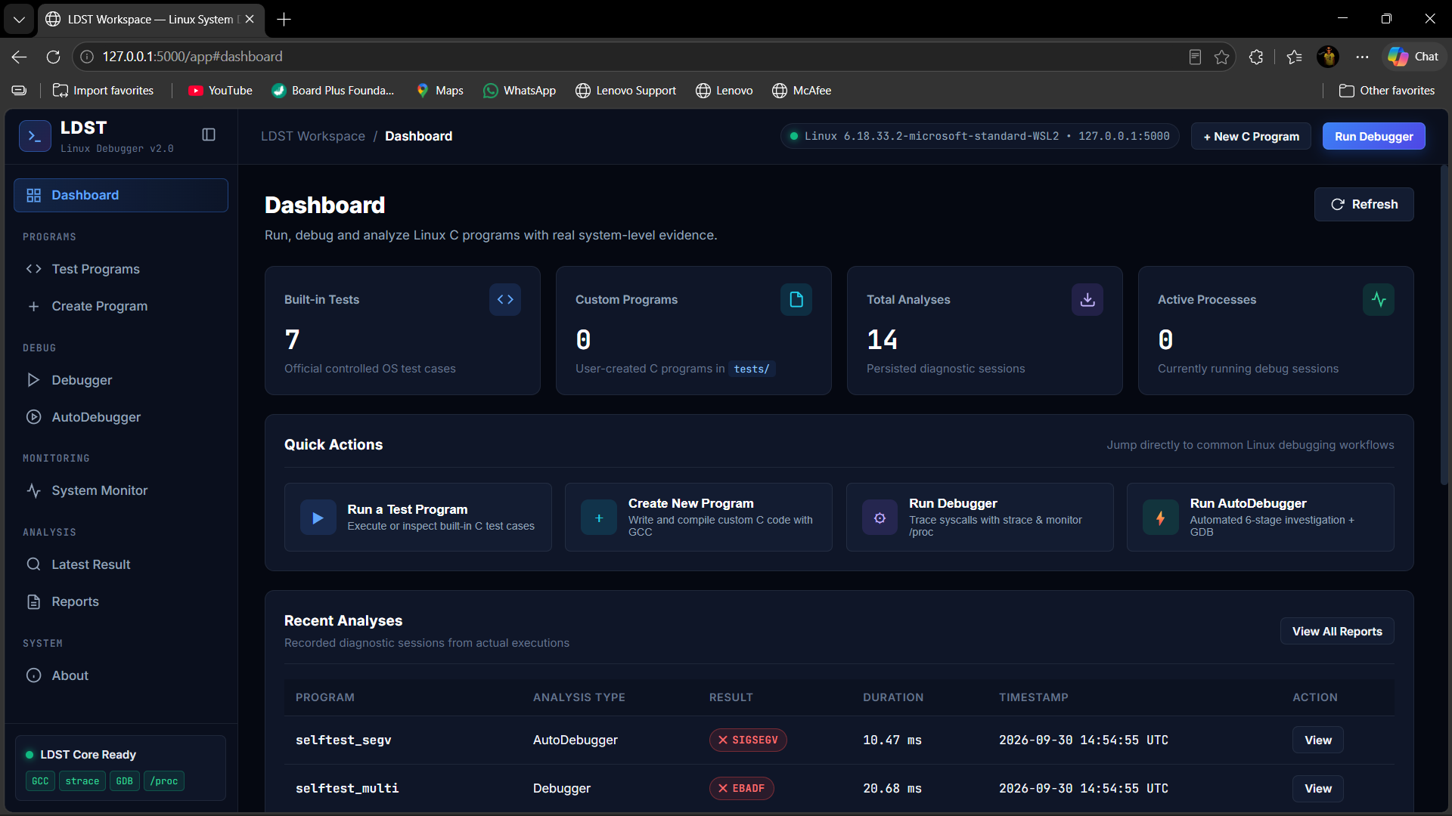
Why LDST?
Turning low-level Linux evidence into an understandable debugging workflow.
The Problem
Dashboard
Program output alone often cannot explain why a Linux C program failed at OS level.
Scattered Tools
GCC, strace, /proc and GDB are powerful, but their evidence normally has to be collected and interpreted separately.
Our Solution
LDST integrates compilation, execution, tracing, monitoring, crash analysis and reports in one local workspace.
The GUI is a control and visualization layer; the debugging evidence still comes from real Linux execution.

Slide 3
System Architecture
Dual interface, one real Linux debugging engine.
GCC
CLI
./ldst
strace
USER
LDST C CORE
Reports
JSON + TXT
/proc
WEB GUI
Browser
Flask
Backend
GDB
Browser does not simulate debugging
It requests actions from the local backend, which invokes the native C core and Linux tools.

Slide 4
How LDST Works
One end-to-end pipeline from C source to evidence-backed diagnosis.
1 CREATE / SELECT
2 COMPILE
3 EXECUTE
4 TRACE + MONITOR
5 ANALYZE
6 REPORT
Built-in or custom C source
Real GCC diagnostics
fork → exec → child
strace + /proc + waitpid
errno, signals, GDB
GUI + JSON + TXT
Core principle
No fabricated diagnostics. PIDs, errno values, syscalls, signals, process statistics and GDB frames are shown only when captured from actual execution.

Slide 5
What the Latest GUI Adds
A professional local workspace around the original C/Linux core.
Custom C Workspace
Debugger
AutoDebugger
Create, edit and compile user programs with real GCC diagnostics.
Run a target with strace, /proc monitoring and stdout/stderr capture.
Six-stage investigation with GDB crash analysis when appropriate.
Live Process Monitor
Evidence Views
Persistent Reports
PID, PPID, state, memory, threads, file descriptors and CPU telemetry.
Summary, system calls, process info, source, output and raw logs.
Searchable session history with TXT and JSON export.

Slide 6
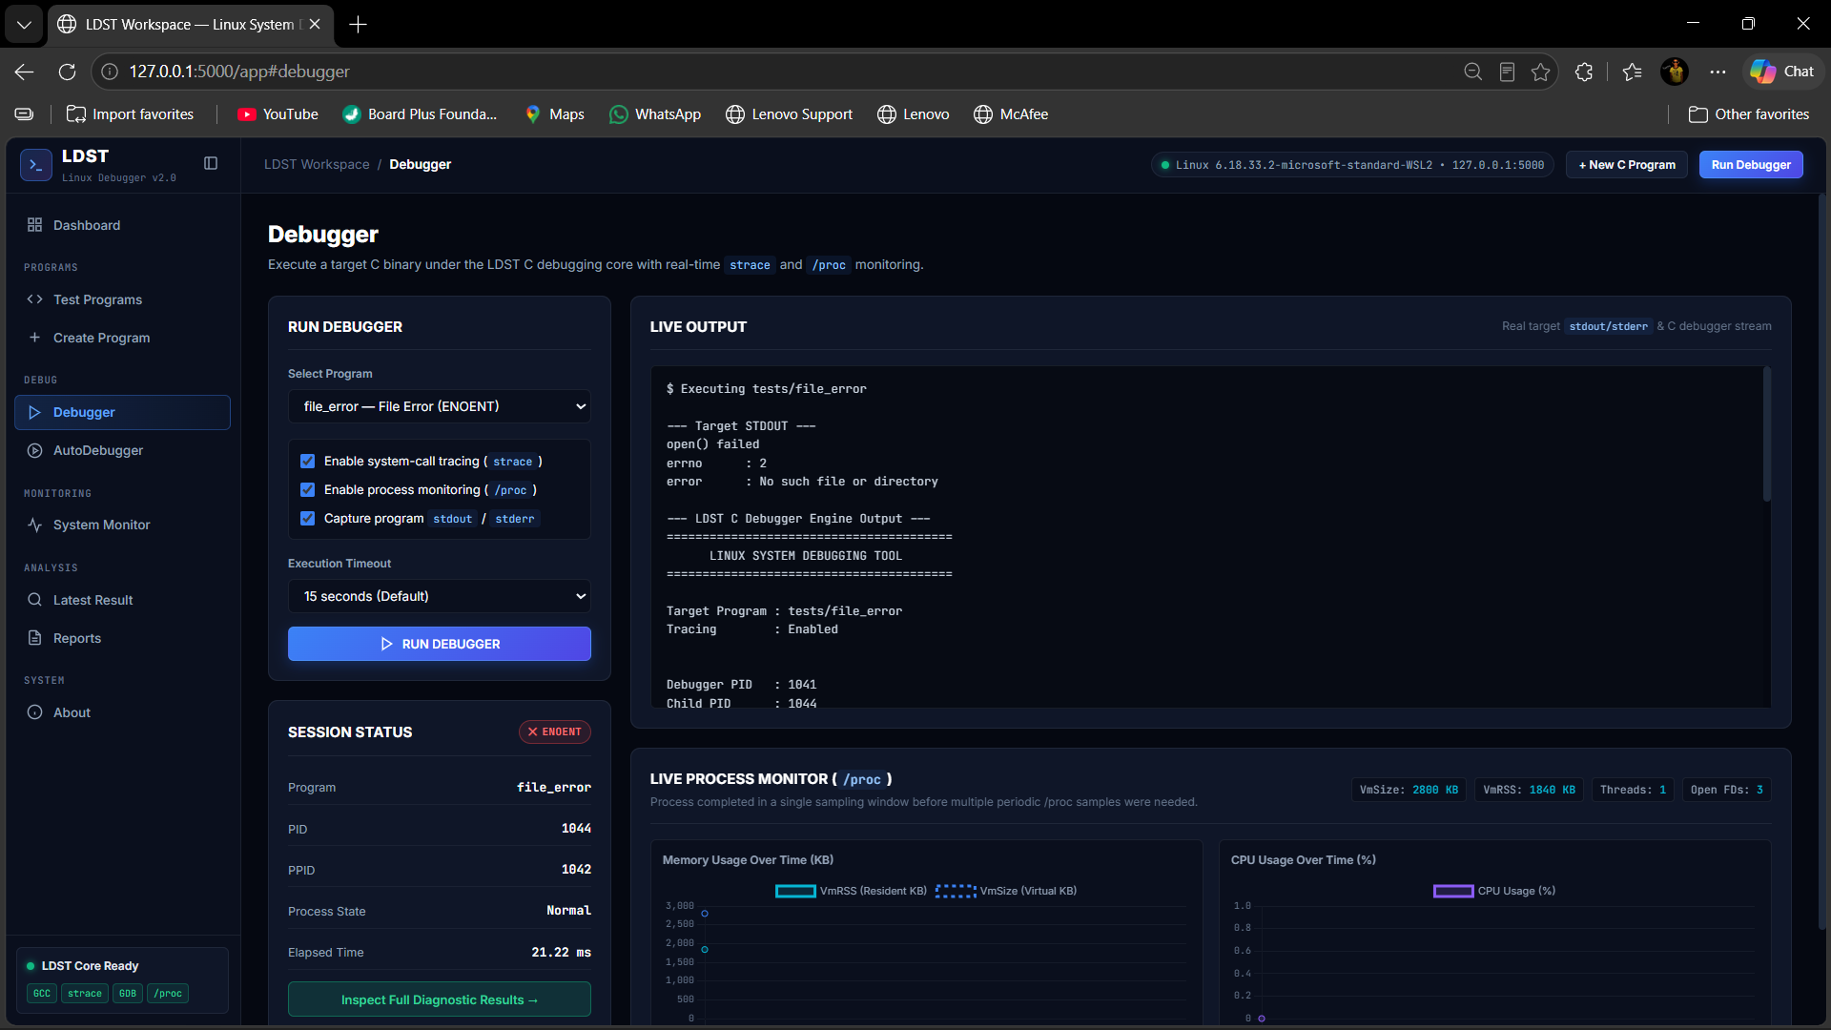
Debugger — Real Execution Evidence
Example: file_error produces a genuine ENOENT failure.
Debugger
Target execution
Runs the selected compiled binary through the native LDST debugger.
System-call tracing
strace captures real calls, return values and errno failures.
Process monitoring
/proc provides process state and resource samples.
Observed result
The shown file_error session reports ENOENT — not a hard-coded demo value.

Slide 7
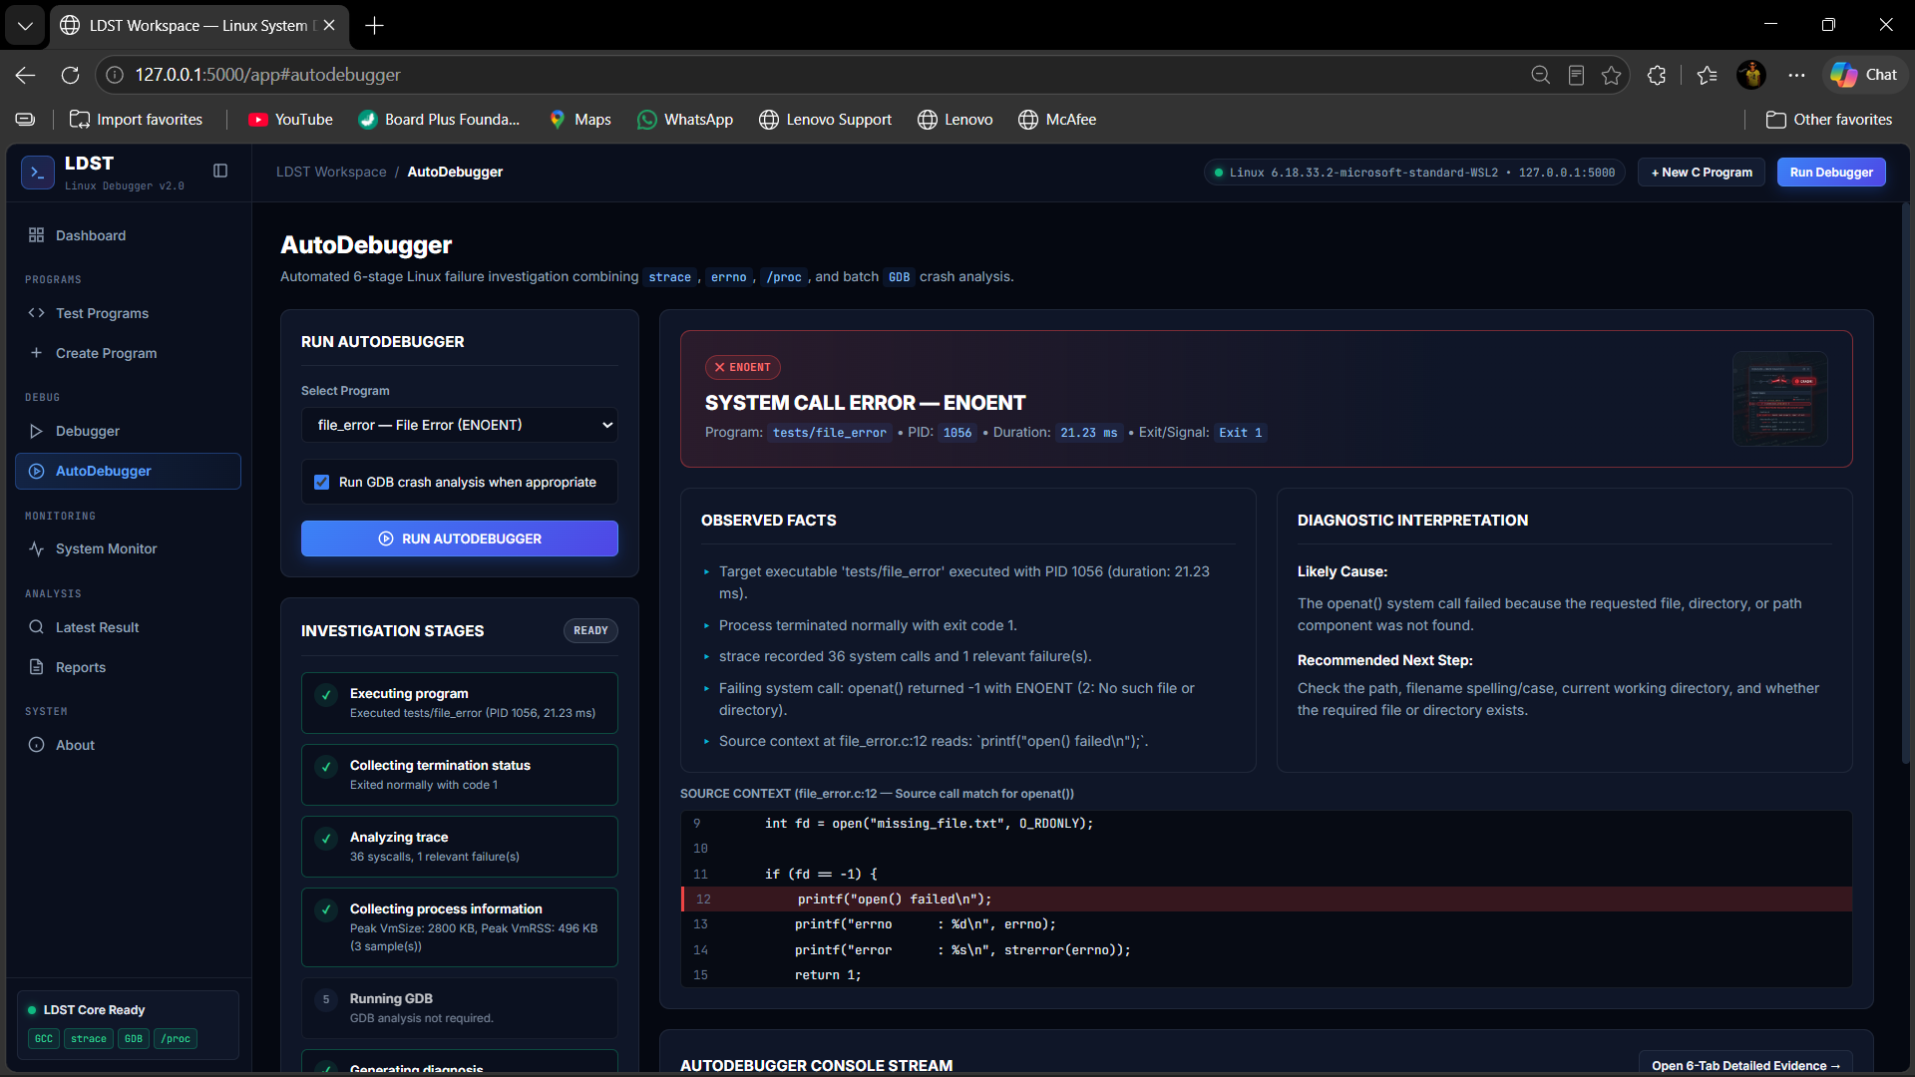
AutoDebugger — From Evidence to Diagnosis
Automates the investigation while keeping observed facts separate from interpretation.
AutoDebugger
6-stage investigation
Execute target
Collect termination status
Analyze strace
Collect /proc data
Run GDB if required
Generate diagnosis
Example shown: openat() → -1 ENOENT, with source context and recommended next step.

Slide 8
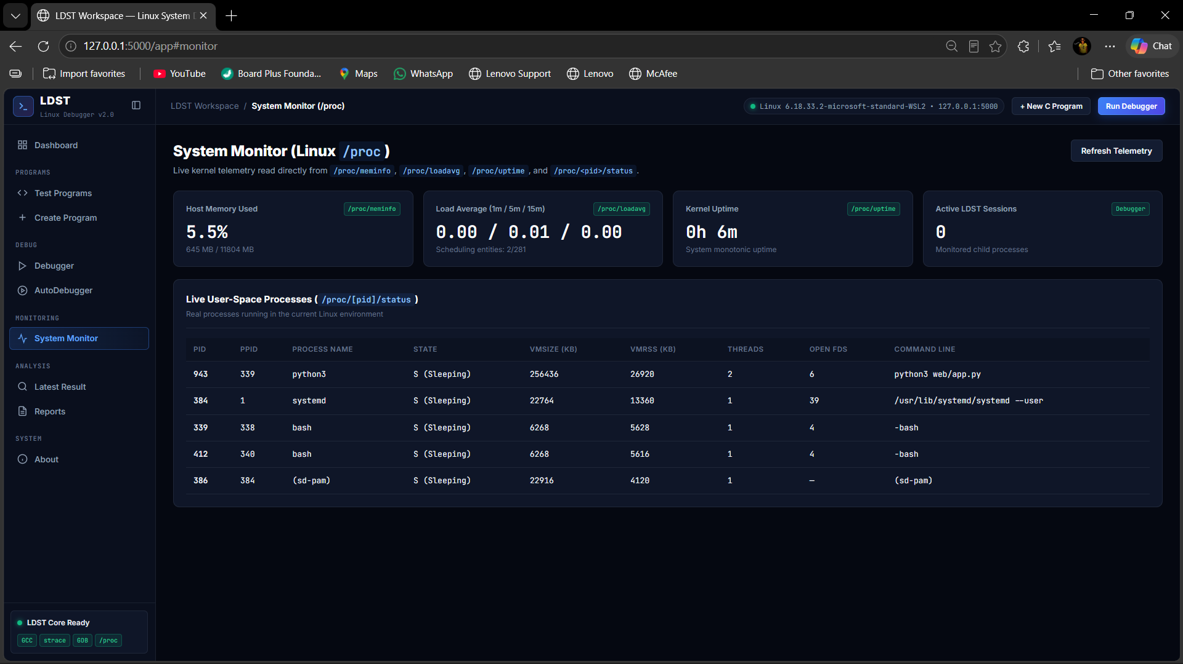
System Monitor — Linux /proc
Kernel telemetry is read directly from the running Linux / WSL environment.
System Monitor
/proc/meminfo
Host memory usage.
/proc/loadavg
1 / 5 / 15 minute load averages.
/proc/uptime
Kernel/system uptime.
/proc/<pid>/status
Per-process state, memory and threads.

Slide 9
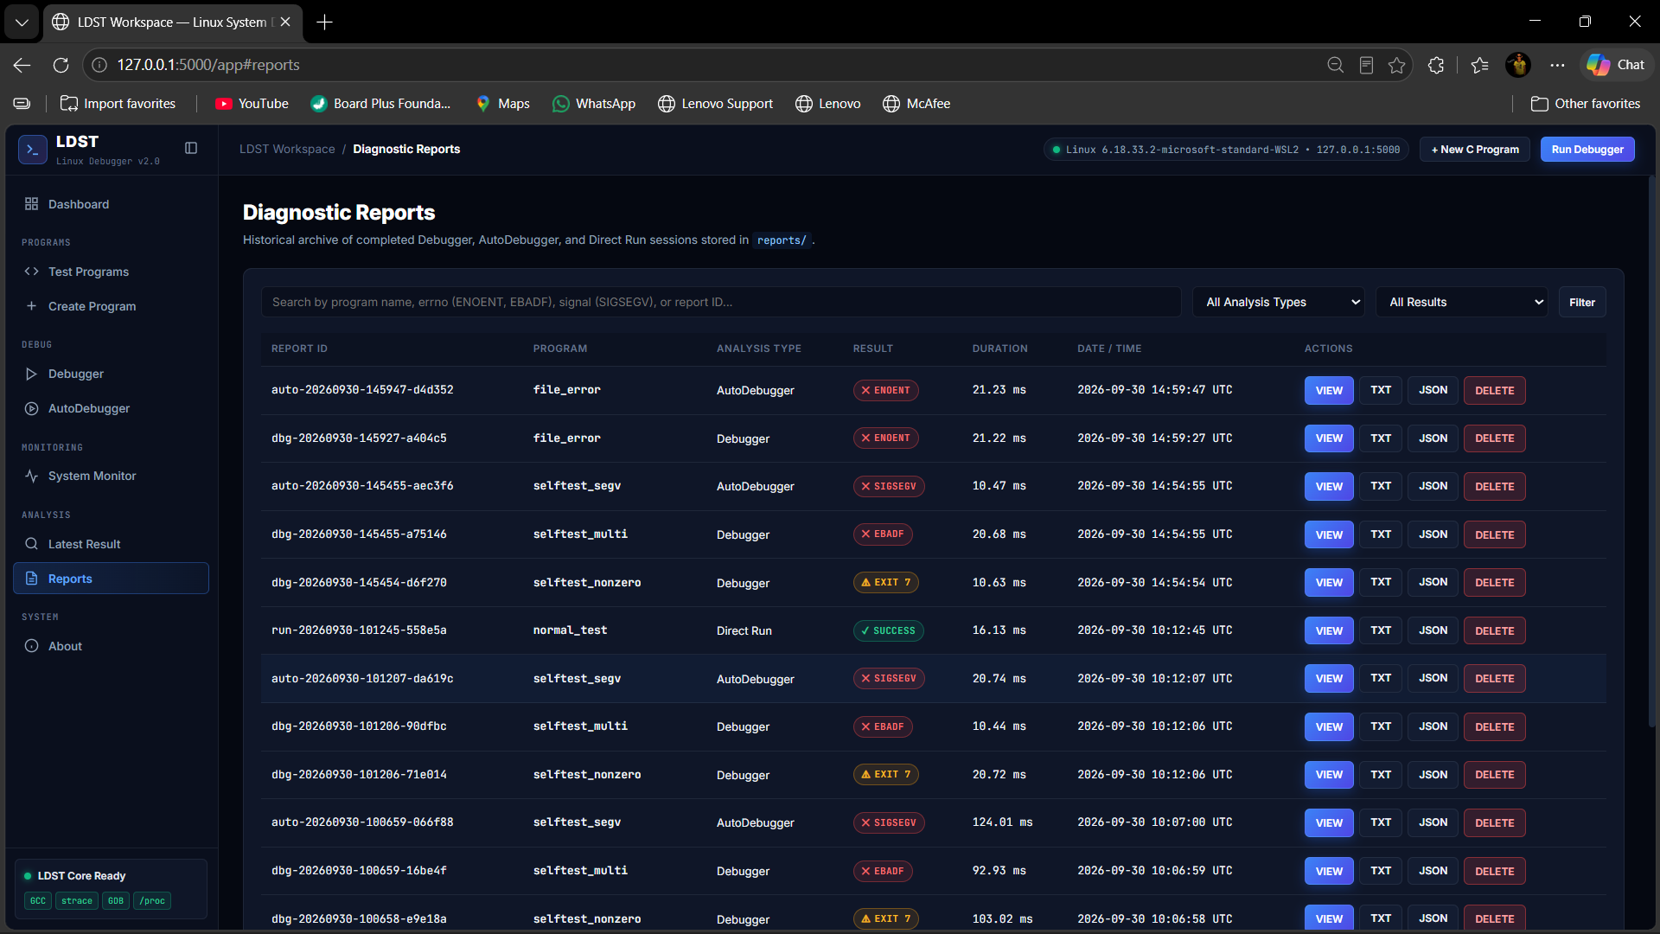
Diagnostic Reports
Every completed session becomes reusable evidence, not disposable terminal output.
Reports
Session history
Program, analysis type, result, duration and timestamp.
Search & filter
Find sessions by program, errno, signal or report ID.
Evidence export
Structured JSON plus readable TXT output.
Examples
SUCCESS • ENOENT • EBADF • SIGSEGV • EXIT 7

Slide 10
Operating-System Concepts Used
The web interface is new; the project remains grounded in systems programming.
fork()
Create controlled child process
execvp()
Replace child with target program
waitpid()
Collect exit status / terminating signal
errno
Decode failed operations
strace
Observe syscalls + signals
/proc
Read runtime process telemetry
Signals
SIGSEGV, SIGTERM and abnormal termination
GDB
Backtrace + source-level crash location
strace explains interaction with Linux; GDB explains program-level crash context. Together they provide complementary evidence.

Slide 11
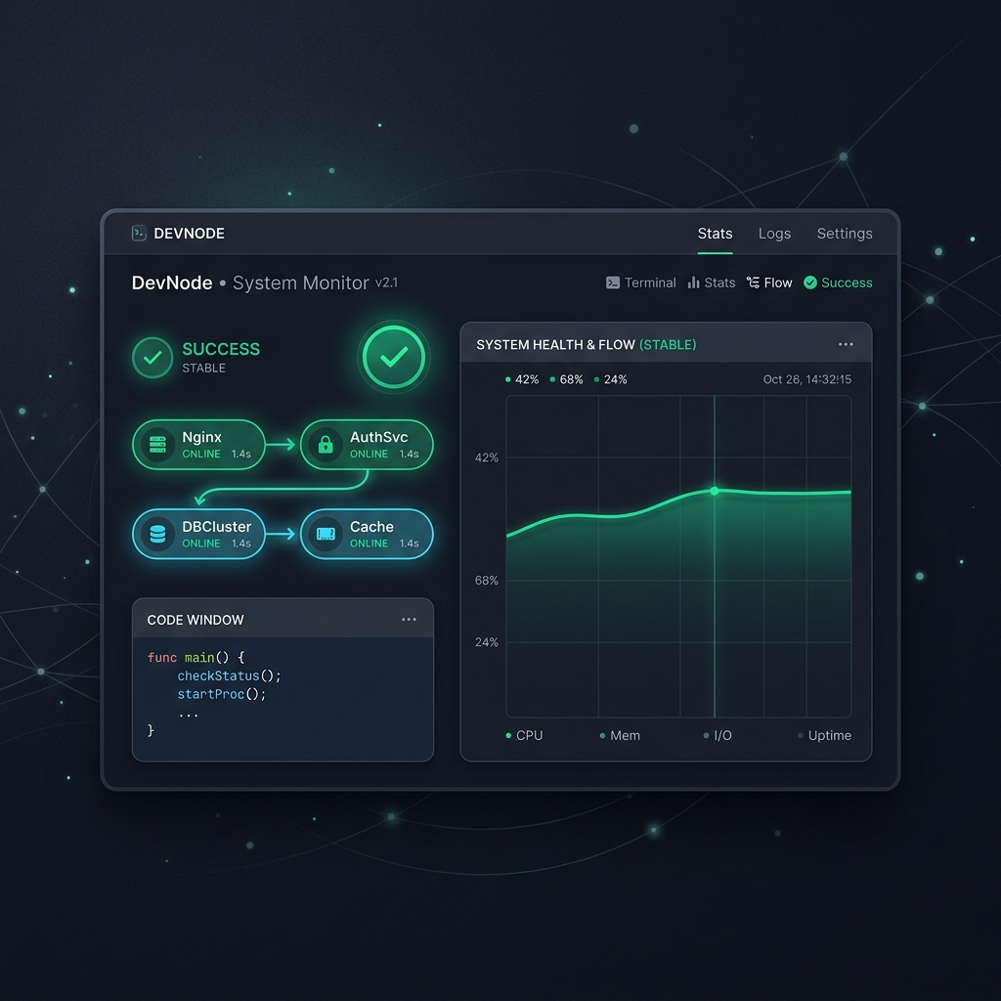
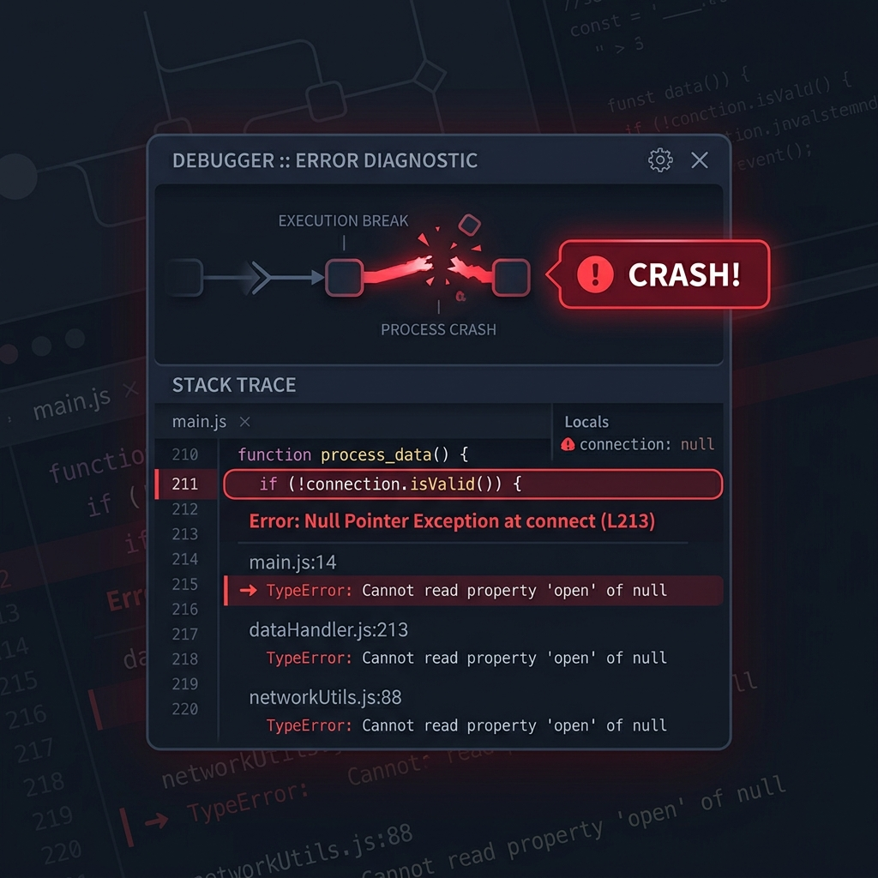
Validation Through Controlled Test Cases
Built-in programs make each OS failure reproducible and explainable.
PROGRAM
PURPOSE
EXPECTED EVIDENCE
normal_test
Clean execution
Exit 0
file_error
Missing file
ENOENT
invalid_fd
Bad file descriptor
EBADF
Testing principle
permission_error
Permission failure
EACCES
A test passes only when the observed Linux/compiler/debugger evidence matches the scenario. Missing tools should be reported as unavailable or skipped—not faked.
abnormal_exit
Signal termination
SIGTERM
segmentation_fault
Invalid memory access
SIGSEGV + GDB

Slide 12
LDST
A practical bridge between C programs and the Linux mechanisms underneath them.
• Real GCC compilation
• Real process execution and termination analysis
• Real strace + errno evidence
• Real /proc monitoring
• GDB-assisted crash investigation
• CLI + premium local web GUI
• Persistent diagnostic reports
THANK YOU • QUESTIONS?

